Slide 1

Google Play Store Analysis
-By
Komal Londhe - AY10453
Sai Manoj Kalasani – FH55174
Viswas Kalyanam – RN49734
Under the guidance of Prof. Waleed Youssef
DATA 603 – Platforms for Big Data Processing

Slide 2
VISWAS
KALYANAM
RN49734
SAI MANOJ KALASANI
FH55174
KOMAL LONDHE
AY10453

Slide 3
TABLE OF CONTENTS
01
02
03
04
INTRODUCTION
DATASET DESCRIPTION
Overview and Problem statements
Source of Data, description of size and columns
METHODOLOGY
RESULTS AND FINDINGS
Approach used for the project
Final conclusions on analysis

Slide 4
Project Objective
Using visualizations determine apps success, categories, top rated apps, best developer.
Use variety of big data tools like Spark, Databricks,SQL
Spark MLlib Rate prediction
Overview
Using spark MLlib - Logistic Regression to predict ratings for the apps (Multinomial Classification)
Evaluate the model
Word2Vec model for user reviews
Classify reviews as positive,negative or neutral.
User reviews are cleaned by removing punctuations, stopwords and numbers
Using Word2Vec - find related words from the reviews

Slide 5
Problem Statement
01
02
What are the top 5 most rated apps?
What is the top 100 most downloaded applications?
03
06
What are the main category of apps downloaded?
Which are the best developers?
04
05
How many reviews are positive, negative or neutral?
What are the related words from the Word2Vec user reviews embedding?

Slide 6

Dataset Description
Dataset Source | https://www.kaggle.com/gauthamp10/google-playstore-apps?select=Google-Playstore.csv
No of Rows | 2312944
Applications | 600,000 Unique Applications
Attributes | 24
Columns | App Name, App Id, Category, Rating, Rating Count, Installs, Minimum Installs, Maximum Installs, Free, Price, Currency, Size, Minimum Android, Developer Id, Developer Website, Developer Email, Released, Privacy Policy, Last Updated, Content Rating, Ad-Supported, In-app purchases, Editor Choice.

Slide 7
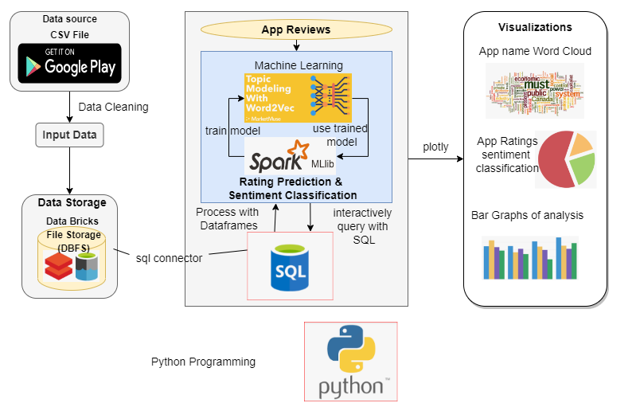
Methodology

Slide 8
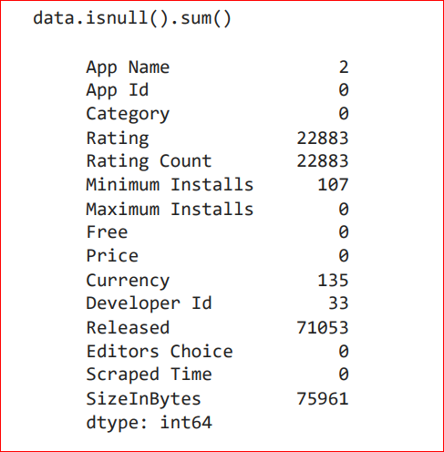
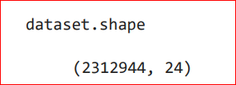
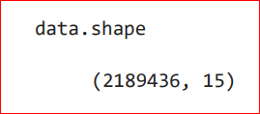
Data cleaning

Slide 9
Findings from EDA
Top 100 most downloaded apps
Best Developer based on the apps developed
Main category of apps download
Donut chart for top 5 rated apps
Pandemic Analysis - Most downloaded app, Top category, Best developer, Top rated app
Pie chart - Distribution of Free vs paid
App Rating distribution using Pie chart

Slide 10
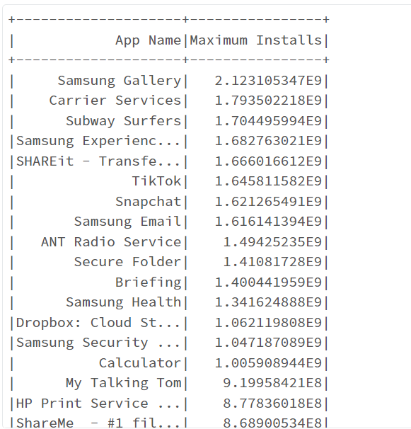
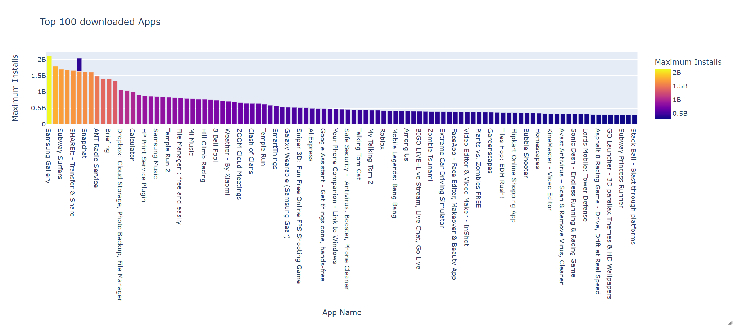
Top 100 most Downloaded Apps

Slide 11
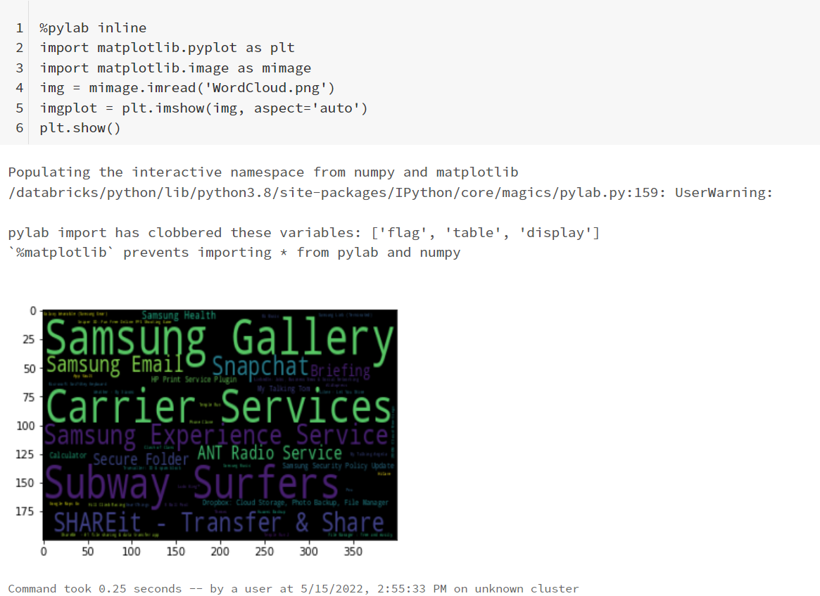
Top 100 most Downloaded Apps Word Cloud.

Slide 12
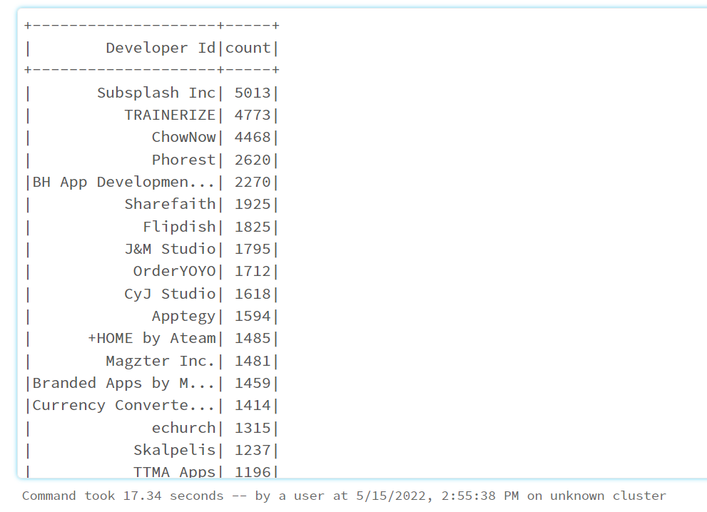
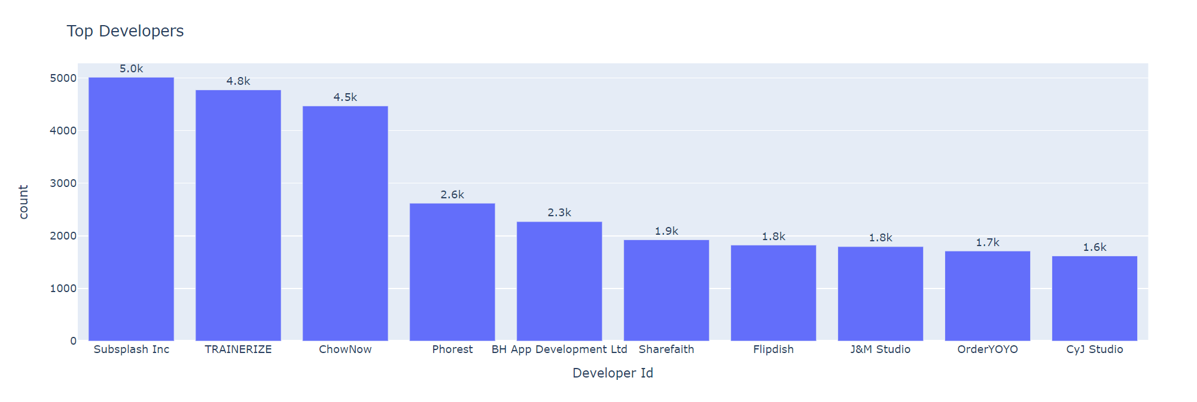
Best Developer Based on the Apps Developed.

Slide 13
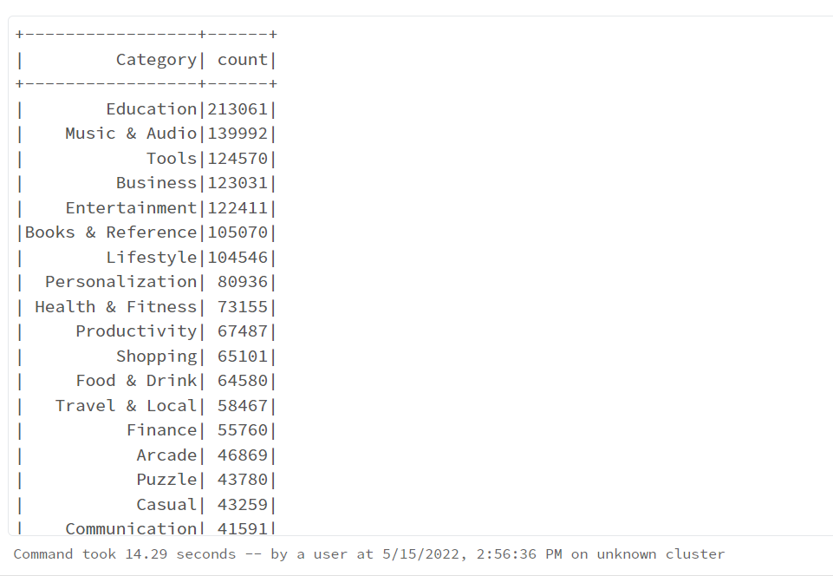
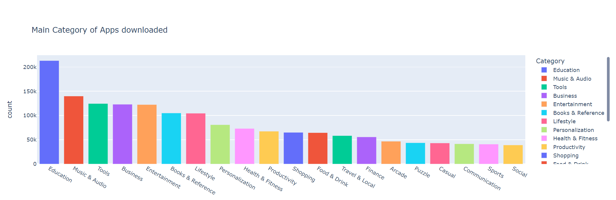
Main Category of Apps Downloaded

Slide 14
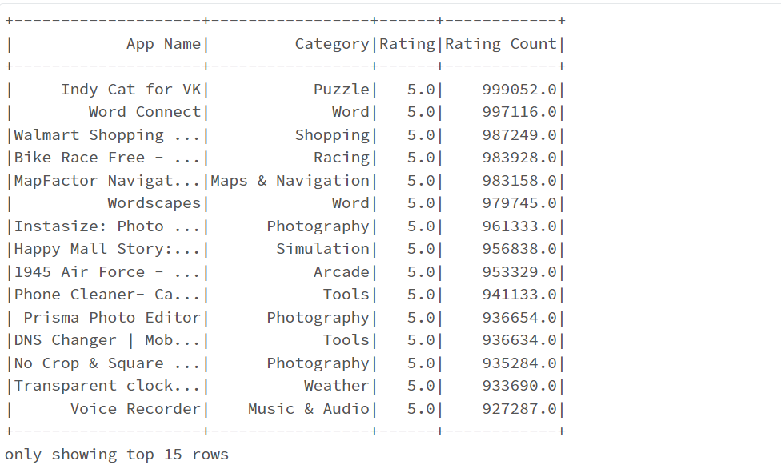
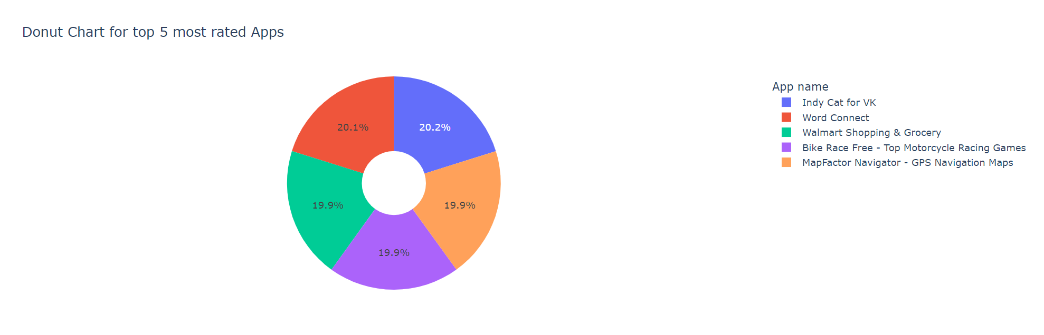
Donut chart for the top 5 most rated apps

Slide 15
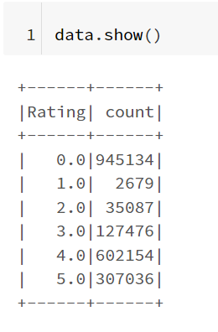
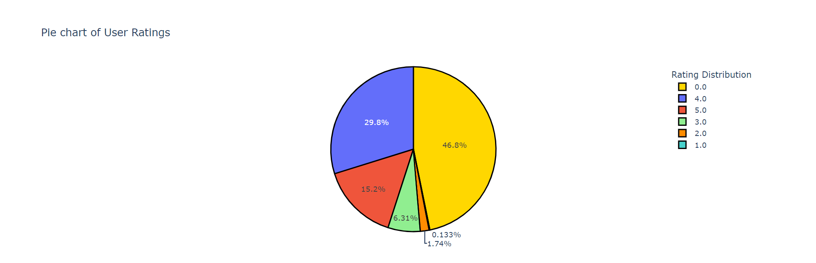
App Rating Distribution

Slide 16
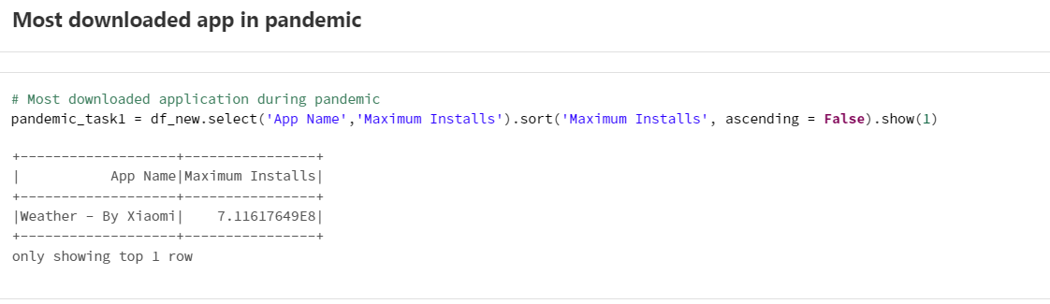
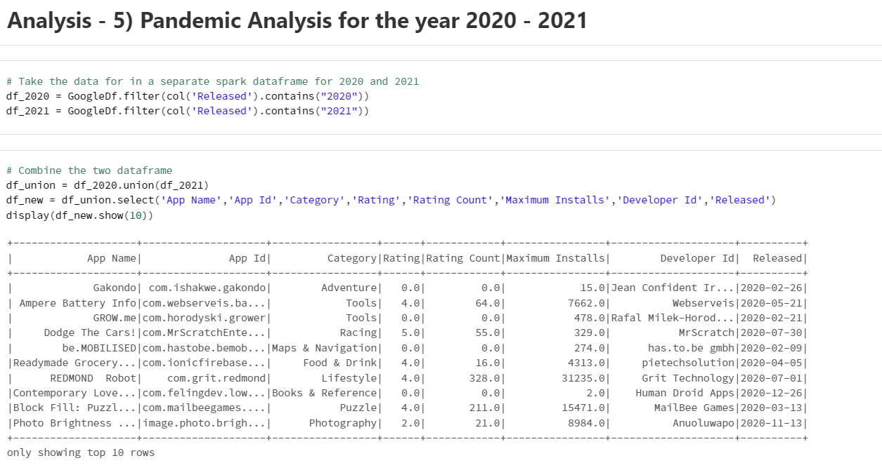
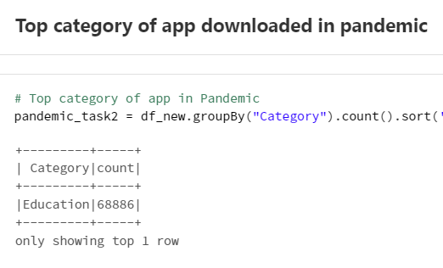
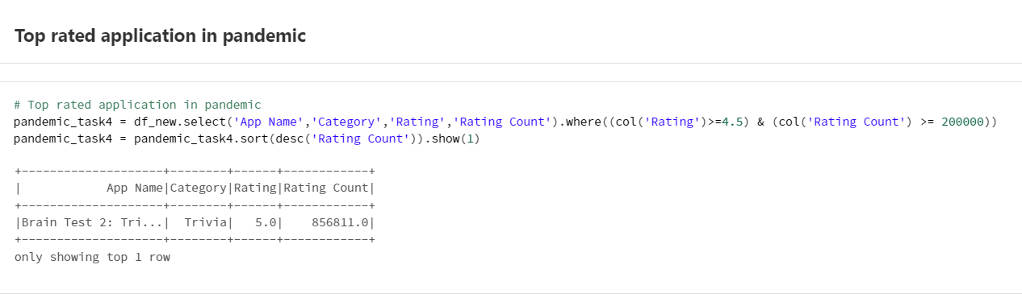
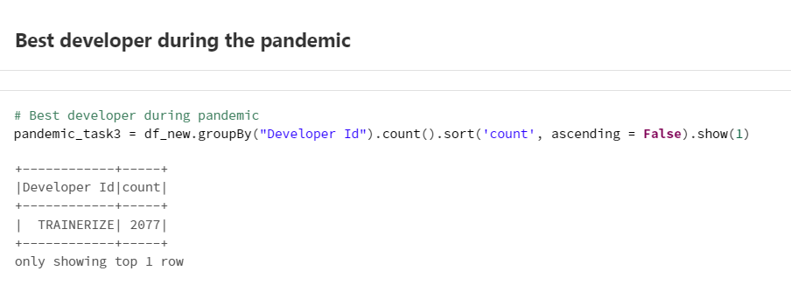
Pandemic Analysis

Slide 17
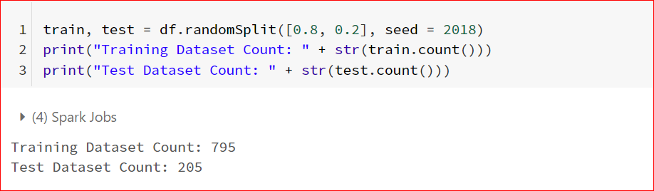
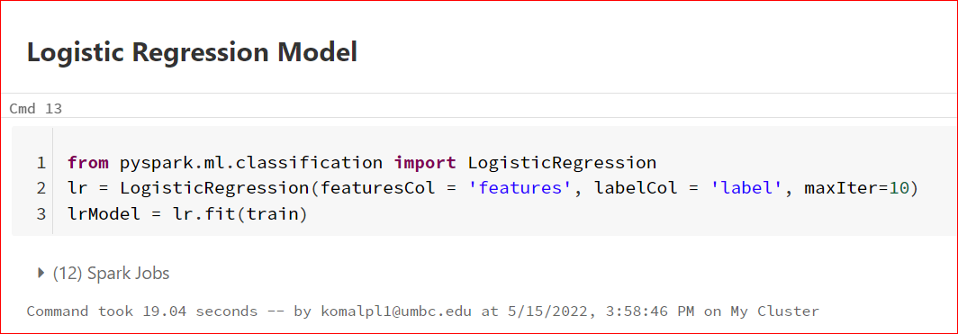
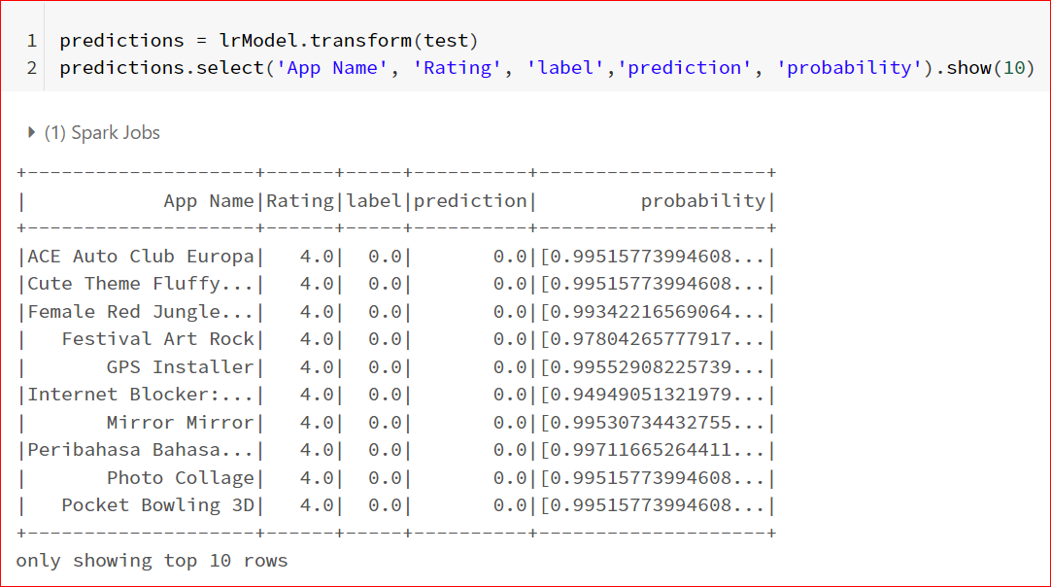
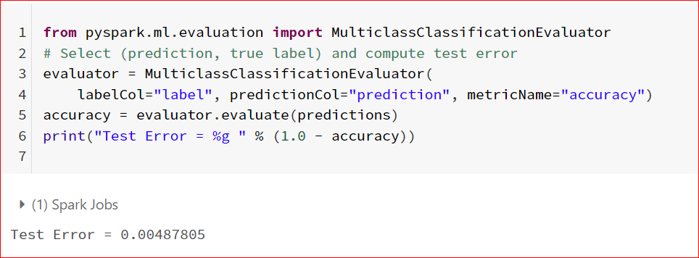
SparkMLlib Rating Prediction

Slide 18
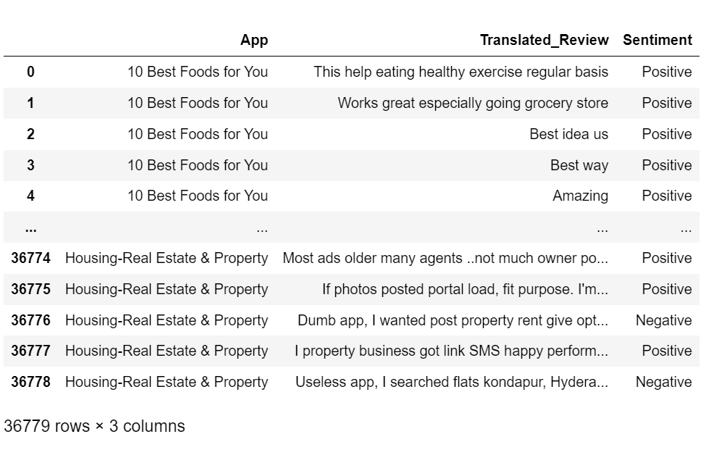
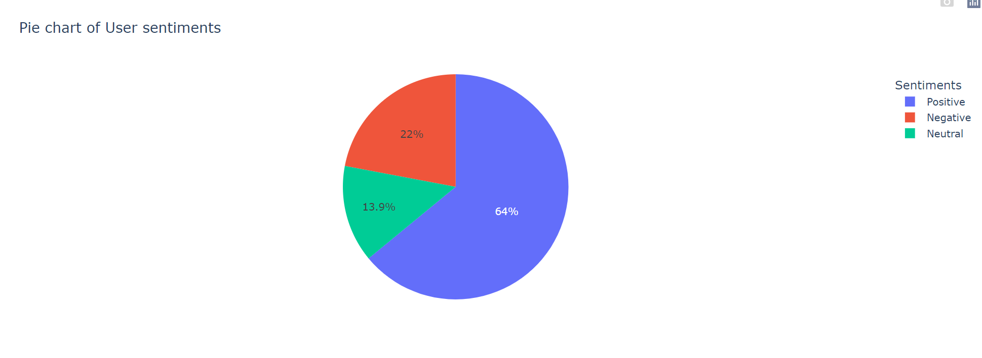
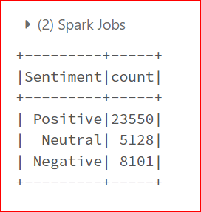
User Reviews - Sentiment Classification

Slide 19
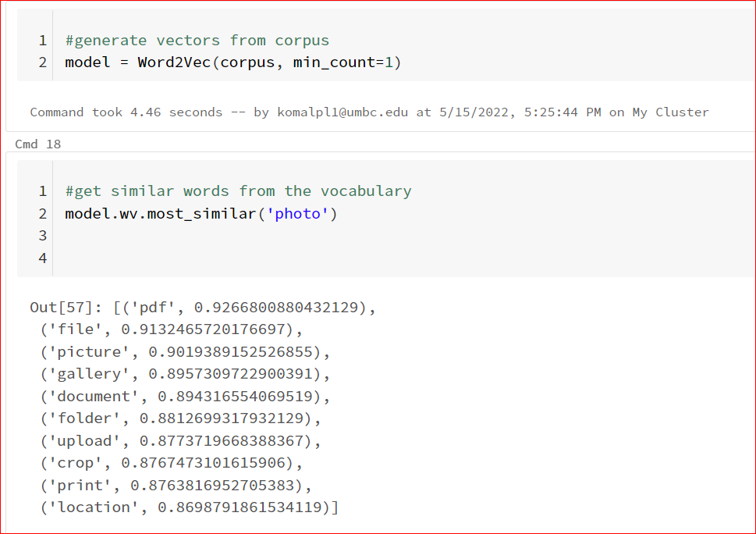
Finding similar words using Word2Vec

Slide 20
Final project different from proposal
Implemented PySQL to store the data in the database instead of MongoDB.
Implemented plotly to get best visualizations from the data.
Additionally, Implemented Rating prediction using Spark MLlib - Logistic Regression model

Slide 21
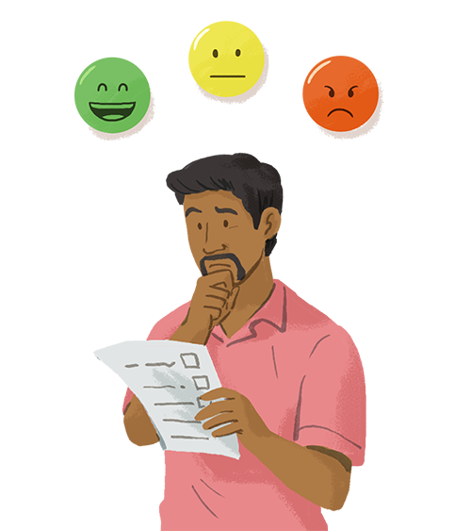
Results and Findings
Pandemic Analysis of Google play store applications
Classified the reviews as positive, negative and neutral
Generated WordCloud, Bar graphs, pie-charts, donut charts from analysis
Find related words by developing Word2Vec model
Using EDA we tried to find the best app, best developer, top categories, top rated apps, free vs paid, Rating distribution
Used SparkMLlib - Logistic Regression model to predict Ratings

Slide 22
Conclusion
Analysis can help understand comprehensive picture about App market
Help developers understand customer desire and trends
Rate Prediction will further be useful in deploying applications
Pandemic analysis gave us insights about most useful applications
Word2Vec model can be further used to extract the relatedness, synonym detection and for App recommendations based on user reviews

Slide 23
References:
Chile, A. (2019). Analysis of Google Play Store Application. International Journal for Research in Applied Science and Engineering Technology, 7(6), 2362–2368. https://doi.org/10.22214/ijraset.2019.6398
Mahmood, A. (2019). Identifying the influence of various factor of apps on google play apps ratings. Journal of Data, Information and Management, 2(1), 15–23. https://doi.org/10.1007/s42488-019-00015-w
ICFAI Tech, Hyderabad & ICFAI Tech, Hyderabad, Telangana, India. (2020, December 12). Google Play Store Apps- Data Analysis and Ratings Prediction. Https://Www.Irjet.Net/Archive. https://www.irjet.net/archives/V7/i12/IRJET-V7I1248.pdf
Mokarizadeh, S. (2013, May 8). SCITEPRESS - SCIENCE AND TECHNOLOGY PUBLICATIONS. Https://Www.Scitepress.Org/. https://www.scitepress.org/Papers/2013/45020/

Slide 24


Slide 25


